Slide 1

Loops
Loops are constructs that control repeated executions of a block of statements.
The concept of looping is fundamental to programming.
Java provides three types of loop statements:
while loops, do-while loops, and for loops.

Slide 2
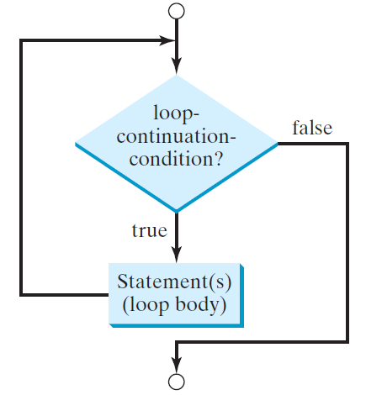
The while Loop
Syntax:
while (loop-continuation-condition) {
// Loop body
Statement(s);
}

Slide 3
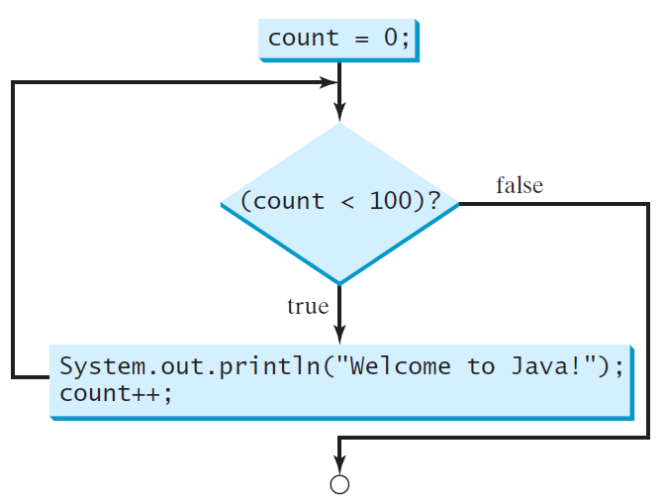
The while Loop
Example:
int count = 0;
while (count < 100) {
System.out.println("Welcome to Java!");
count++;
}

Slide 4
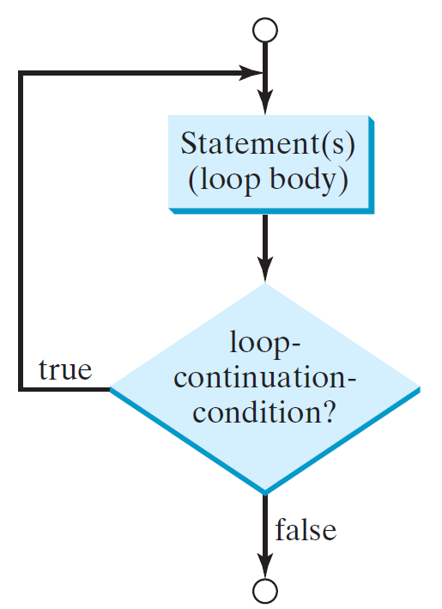
The do-while Loop
Syntax:
do {
// Loop body
Statement(s);
} while (loop-continuation-condition);

Slide 5
The do-while Loop
Example:
int count = 0;
do {
System.out.println("Welcome to Java!");
count++;
} while (count < 100);

Slide 6
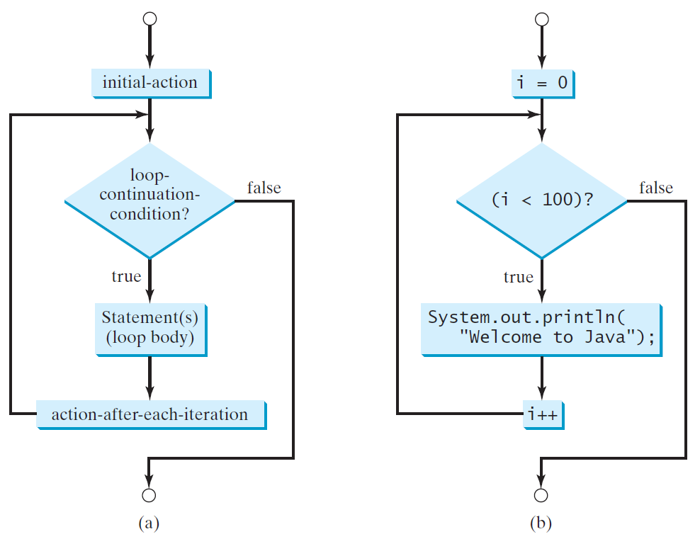
The for Loop
Syntax:
for (initial-action; loop-continuation-condition; action-after-each-iteration) {
// loop body;
Statement(s);
}

Slide 7
The for Loop
Example:
int i;
for (i = 0; i < 100; i++) {
System.out.println("Welcome to Java!");
}

Slide 8
The for Loop
Example:
for (int i = 1; i < 100; System.out.println(i++));
for (int i = 0, j = 0; (i + j < 10); i++, j++) {
// Do something
}

Slide 9
Which loop to use?

Slide 10
Which loop to use?
Use the one that is most intuitive and comfortable for you.
In general, a for loop may be used if the number of repetitions is known, as, for example, when you need to print a message 100 times.
A while loop may be used if the number of repetitions is not known, as in the case of reading the numbers until the input is 0.
A do-while loop can be used to replace a while loop if the loop body must be executed before testing the continuation condition.

Slide 11
Using break and continue
break will immediately terminate the loop.
Example:
int sum = 0;
int number = 0;
while (number < 20) {
number++;
sum += number;
if (sum >= 100)
break;
}
System.out.println("The number is " + number);
System.out.println("The sum is " + sum);

Slide 12
Using break and continue
continue statement ends the current iteration so that the rest of the statement in the loop body is not executed.
Example:
int sum = 0;
int number = 0;
while (number < 20) {
number++;
if (number == 10 || number == 11)
continue;
sum += number;
}
System.out.println("The sum is " + sum);

Slide 13
Any Questions?

